Slide 1
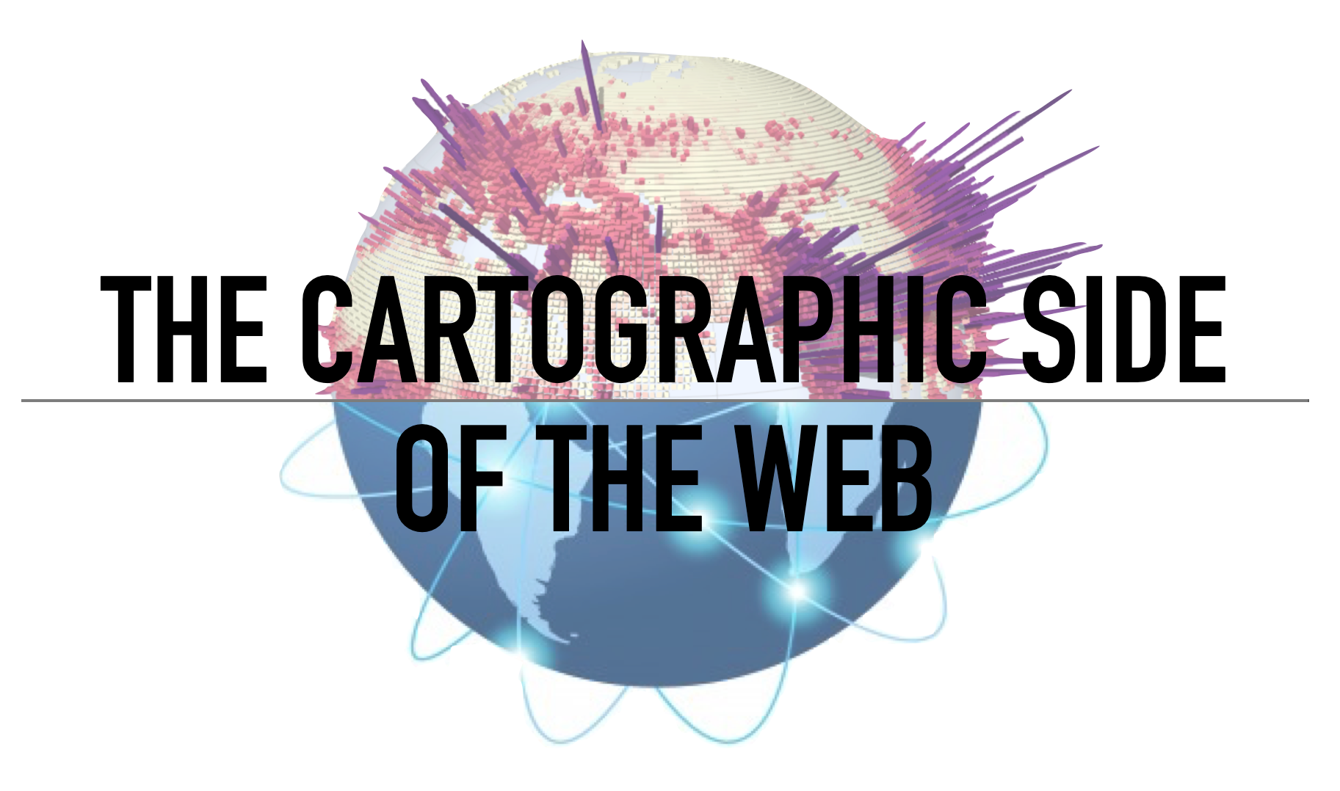
Raluca Nicola – Web Cartographer at Esri
Digital Ideation, Hochschule Luzern – September 29, 2022

Slide 2
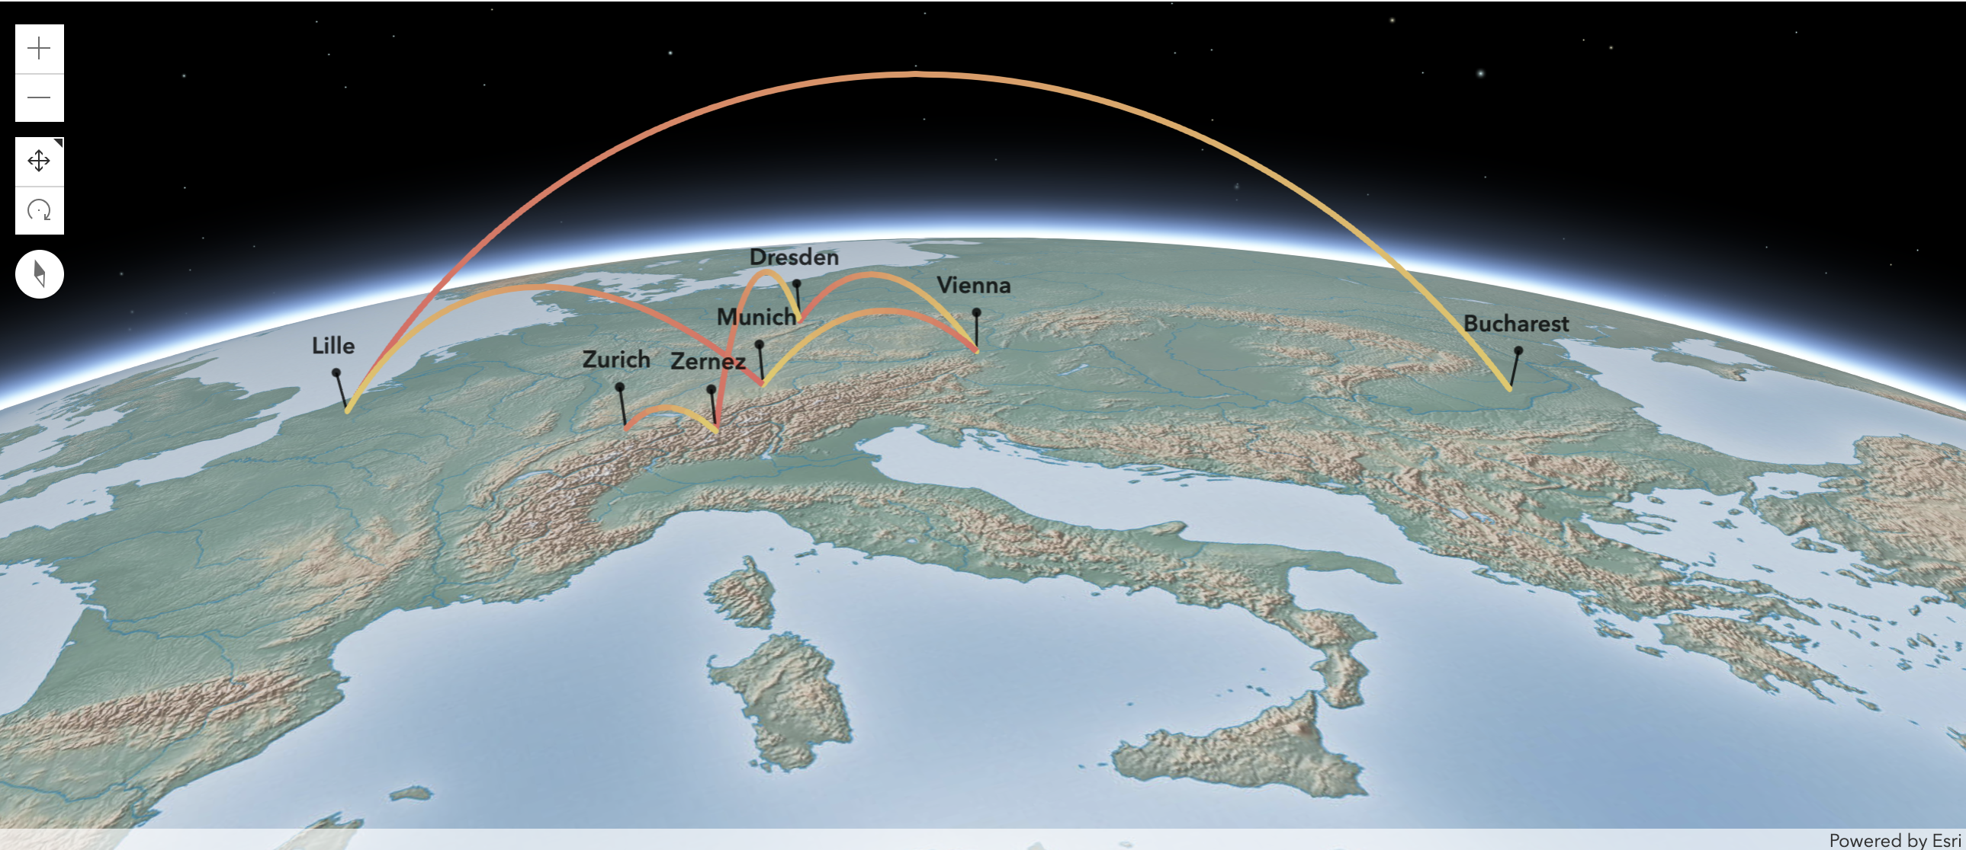
About me
Bachelor in Geography, University of Bucharest
Erasmus exchange, Lille Technical University
International Master of Cartography,
Technical Universities of Munich, Vienna and Dresden
GIS Internship, Swiss National Park
Teaching Assistant, Cartography Institute ETH Zurich
Cartographer, Esri R&D Center Zurich

Slide 3
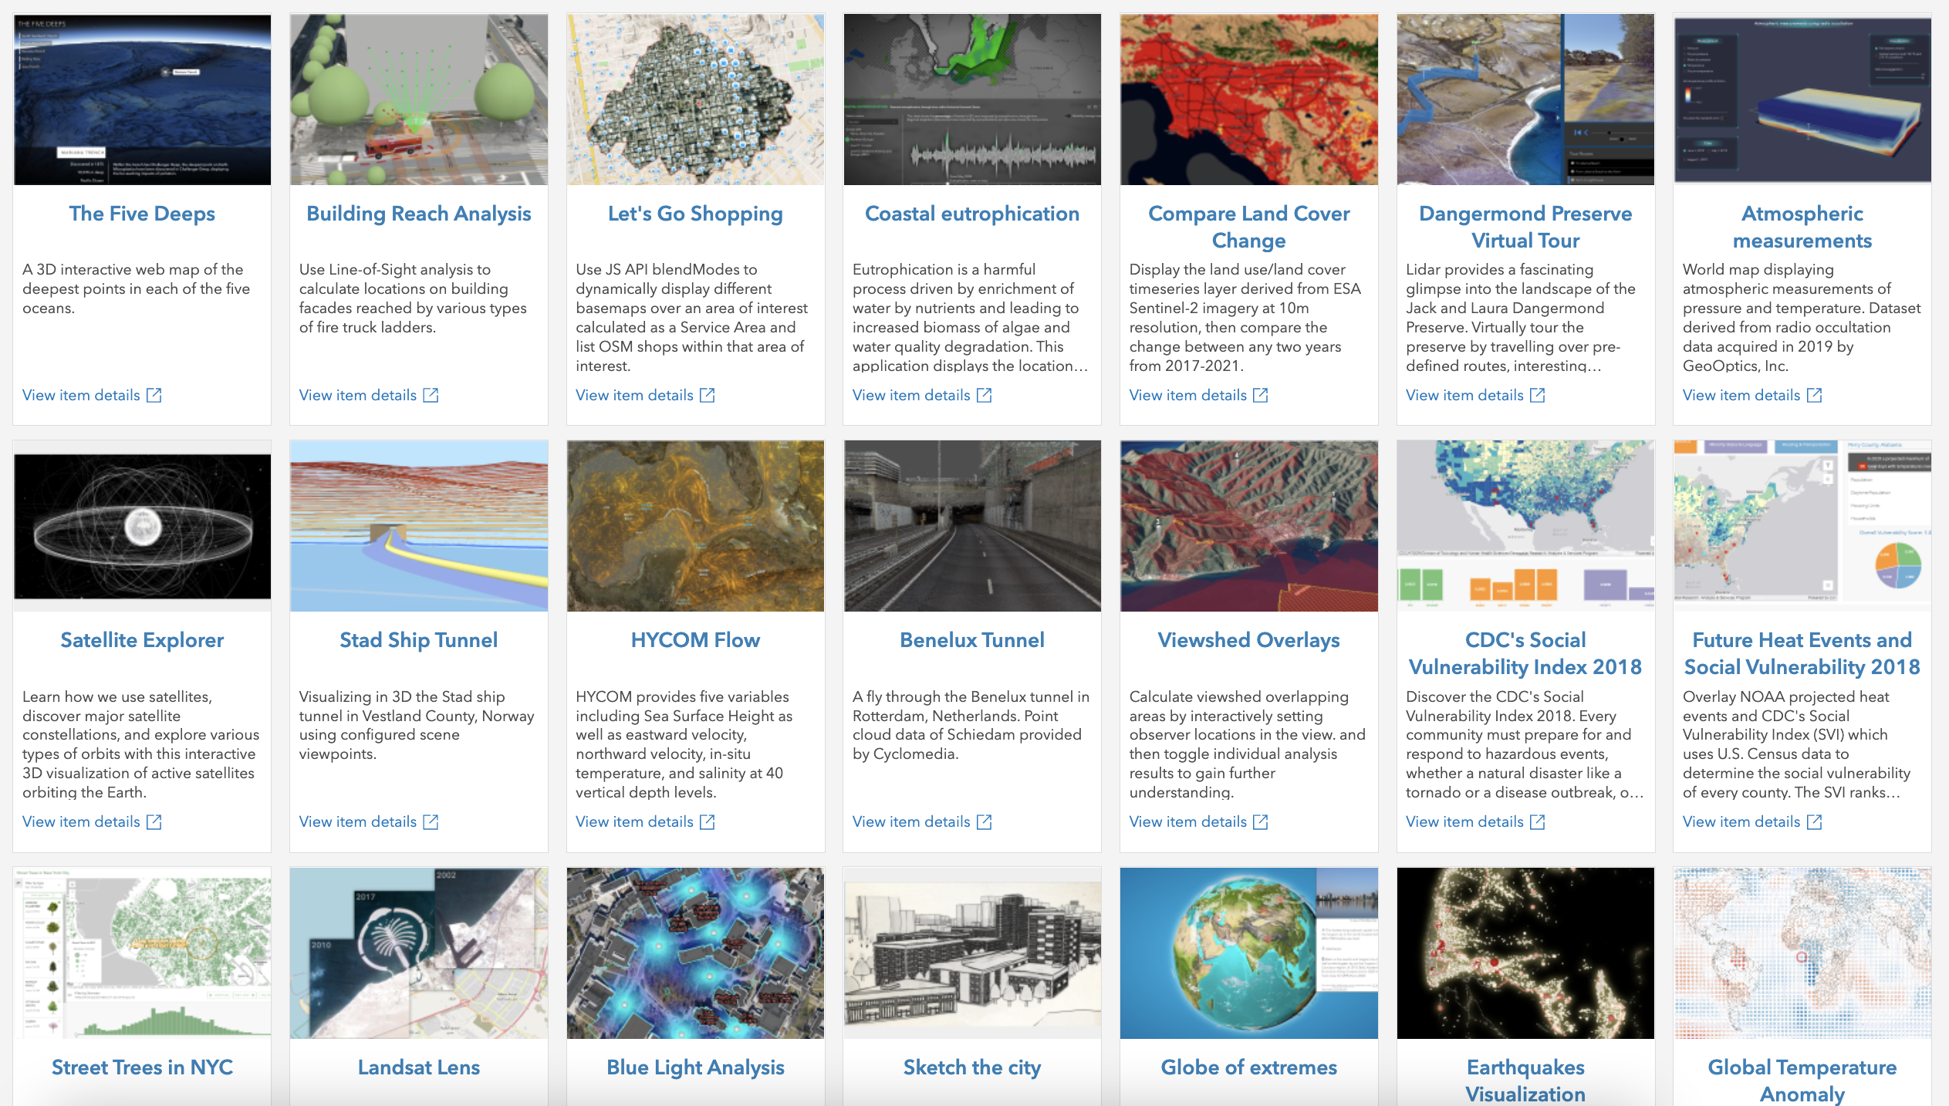

My daily work
Build custom web mapping prototypes and demos as part of the Application Prototype Lab team

Slide 4
Agenda
Workflow when creating maps
Idea > Data > Design > Implement > Test > Share
Examples

Slide 5
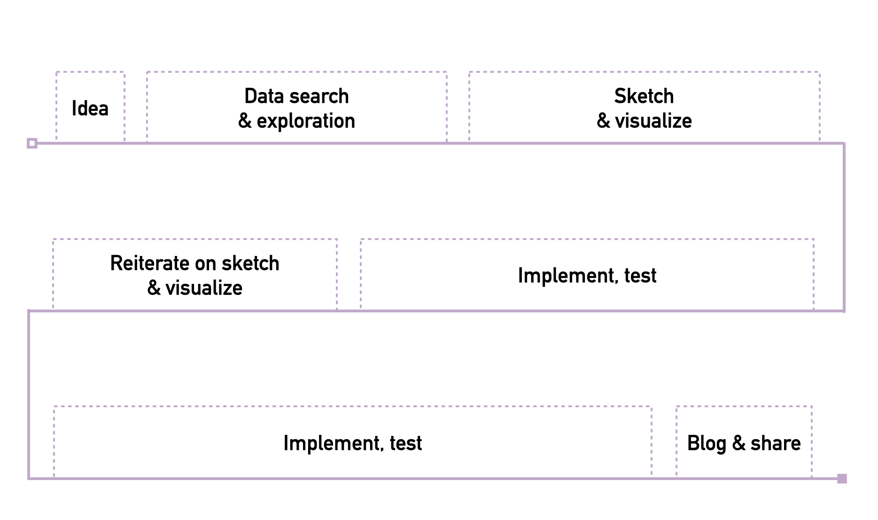
Workflow

Slide 6
Idea
Question
Example: where is the highest internet speed connection?
Inspiration
Example: a map you saw in a magazine or in a game
Personal curiosities
Example: where did James Bond travel so far?

Slide 7
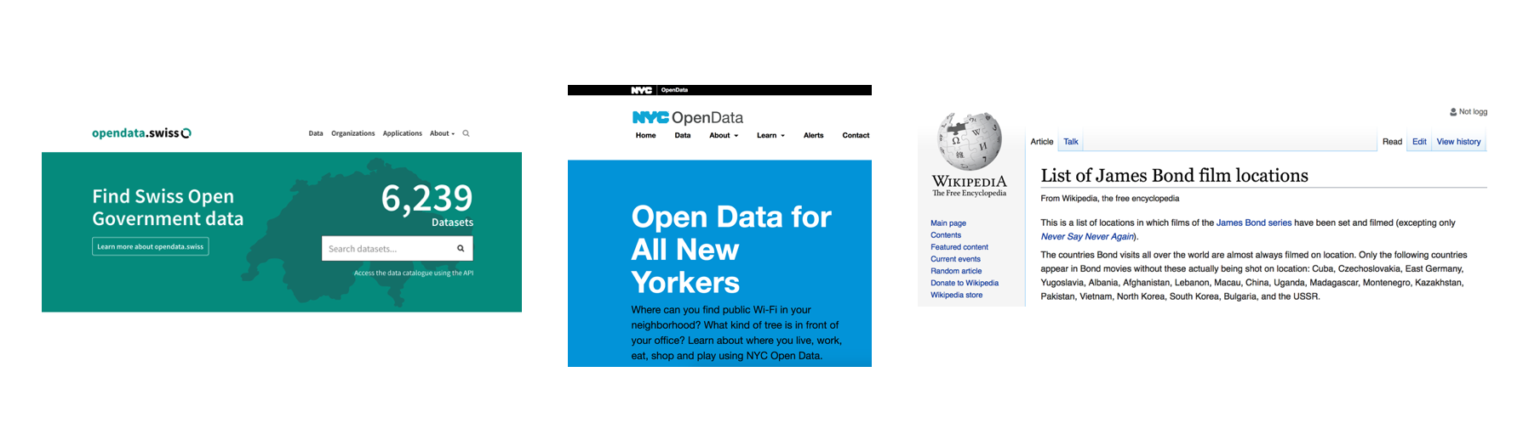
Data search and exploration
Get data from open data portals/parse it from websites
Explore data in ArcGIS Pro, QGIS, Excel, R, ArcGIS Online, Mapbox Studio

Slide 8
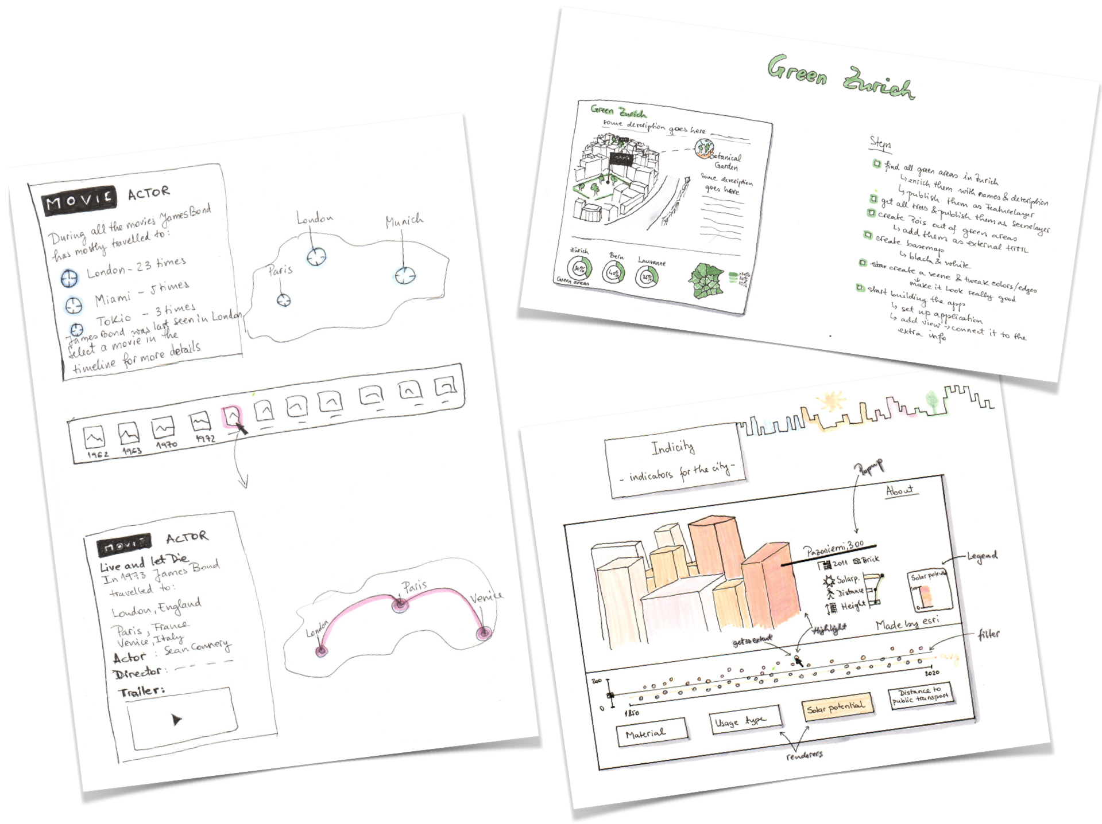
Sketch your ideas

Slide 9
Mapping libraries
Leaflet
ArcGIS API for JavaScript
Mapbox GL JS
CesiumJS
deck.gl
D3
ThreeJS
OpenLayers
Google Maps Platform – Maps JavaScript API
HERE Maps API for JavaScript
General visualization purpose
Mapping specific

Slide 10
Develop, test and share
code, code, 🍫, code
test, test
code, some more 🍫, code, code
show app to my colleagues and get feedback
code, 🍭, code
some more feedback
some more code
deploy, write blog post and share with everyone 🎉 🎊

Slide 11
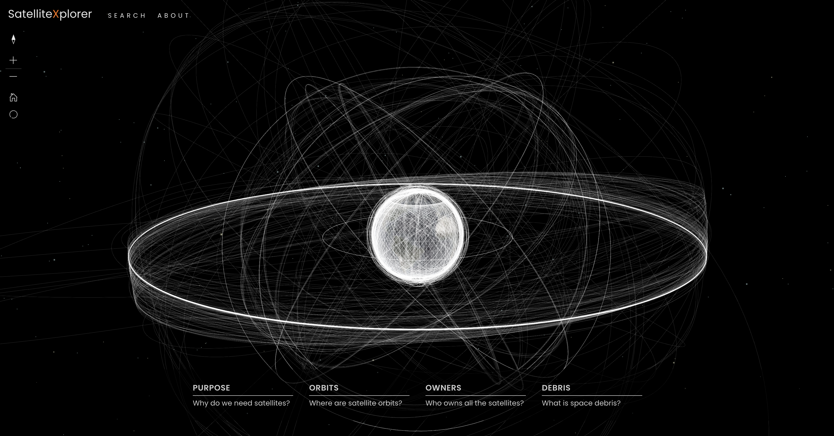
Space - satellite explorer
https://geoxc-apps.bd.esri.com/space/satellite-explorer/

Slide 12
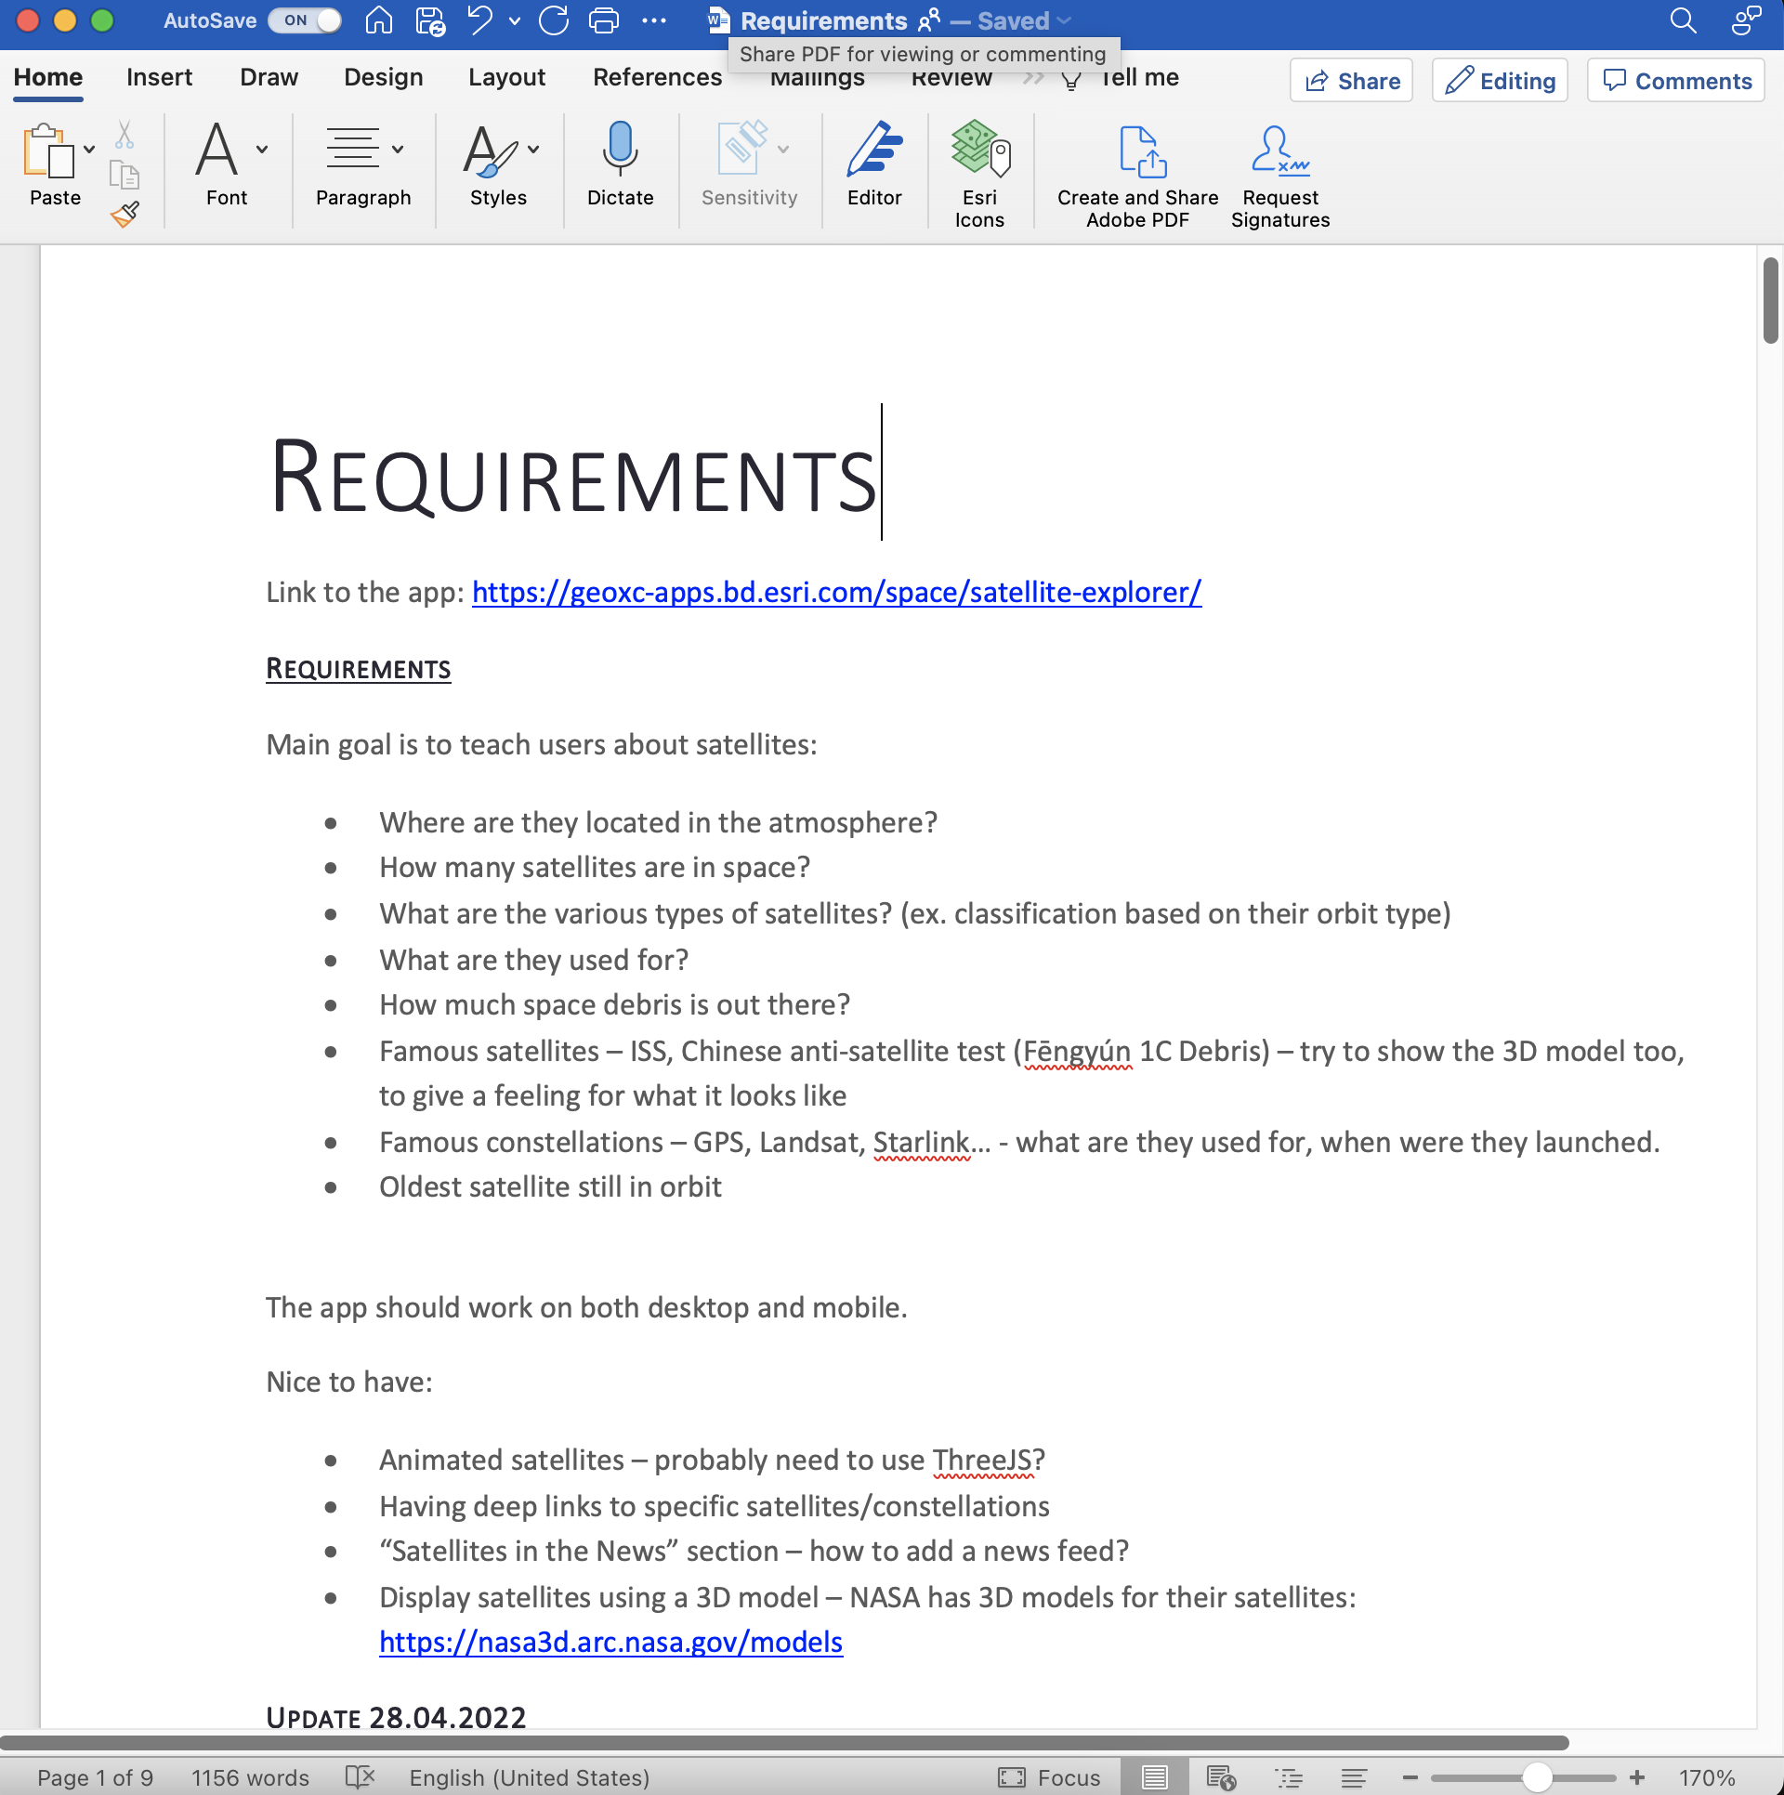
Satellite Explorer - idea

Slide 13
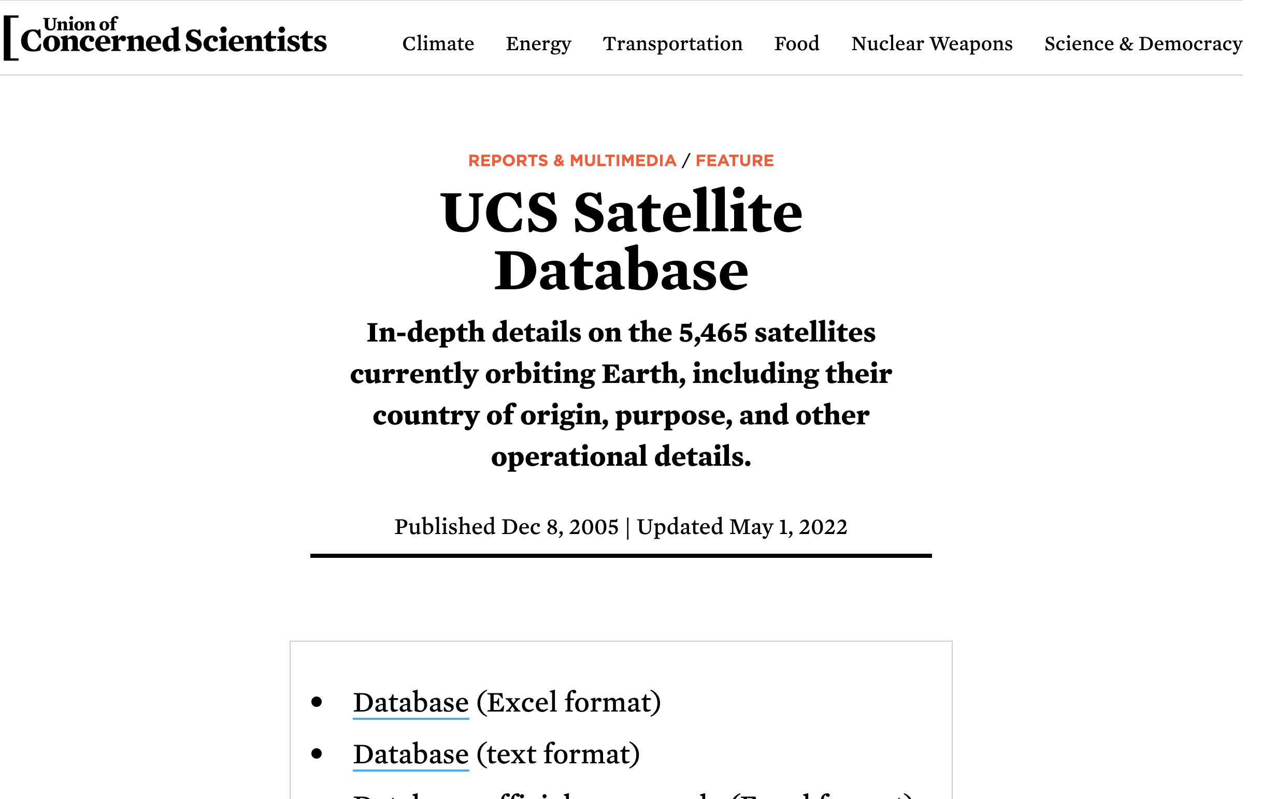
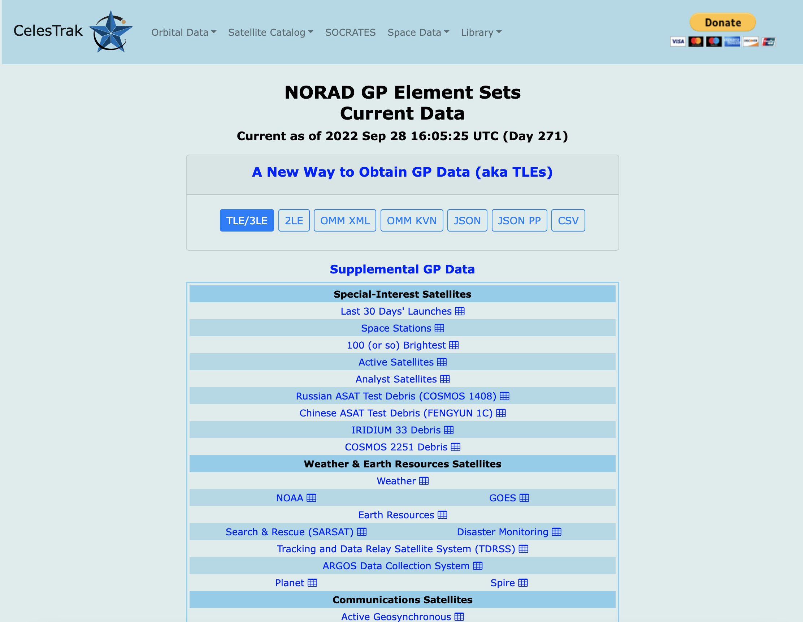
Satellite Explorer – data

Slide 14
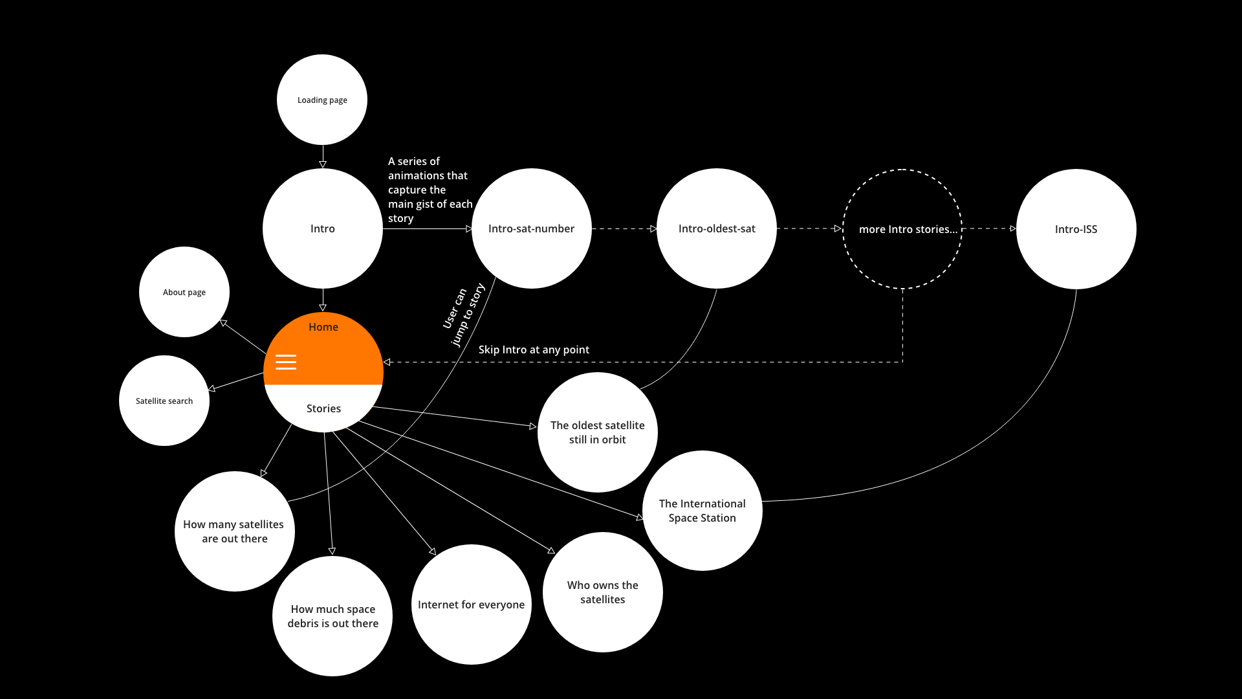
Satellite Explorer - sketch

Slide 15
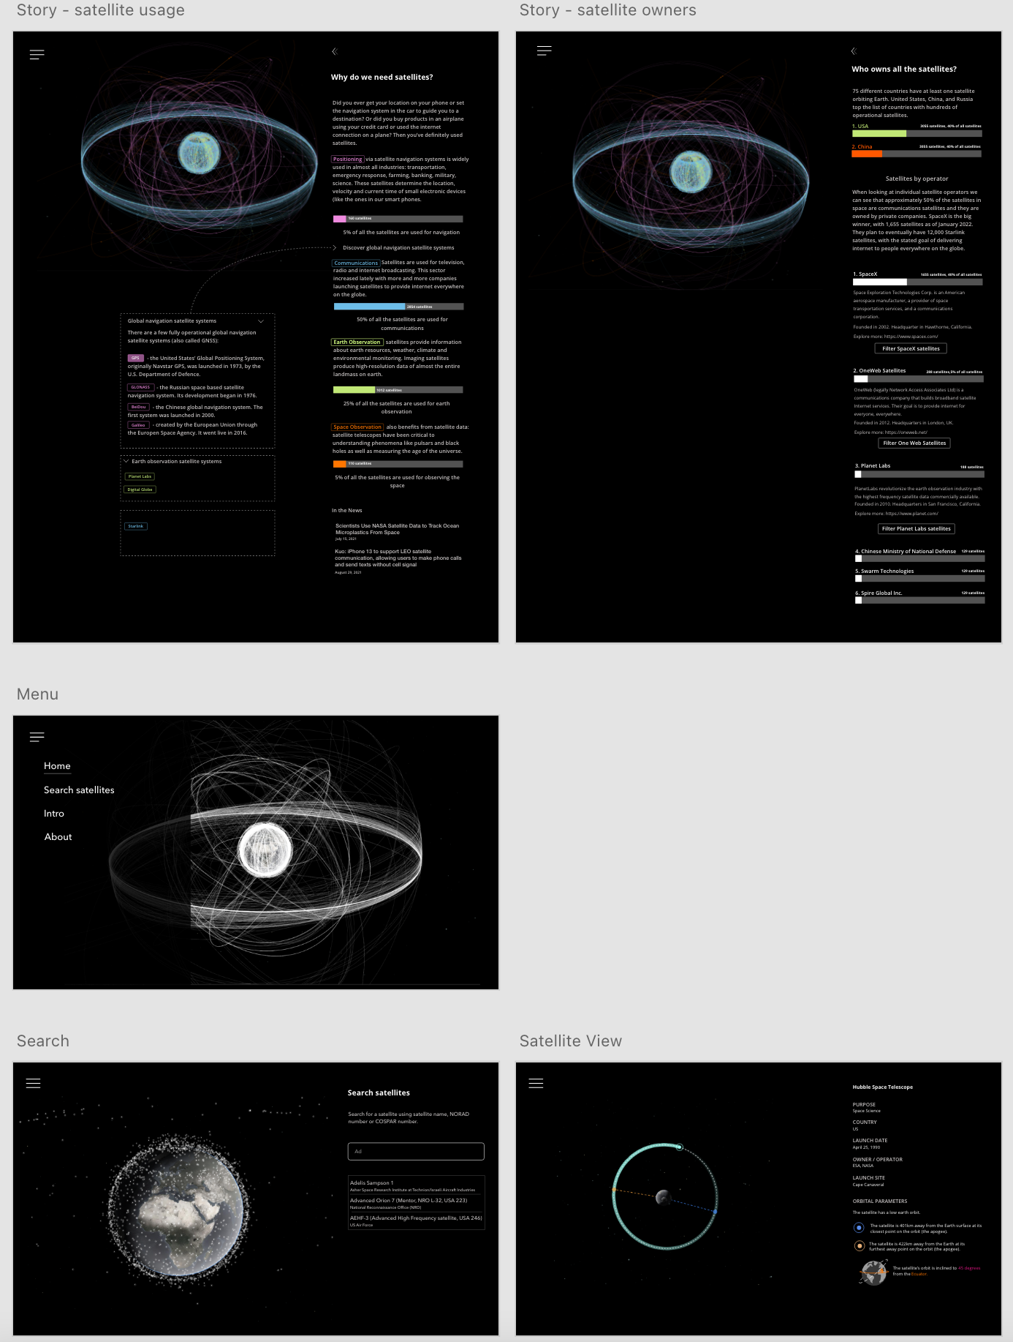
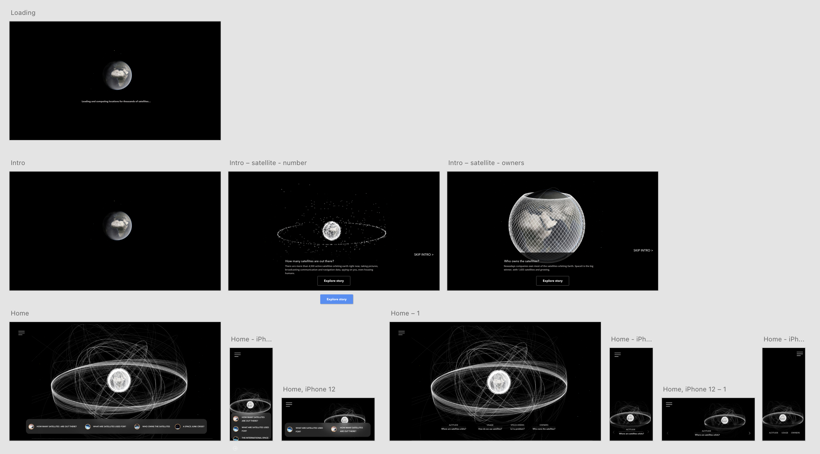
Satellite Explorer - sketch

Slide 16
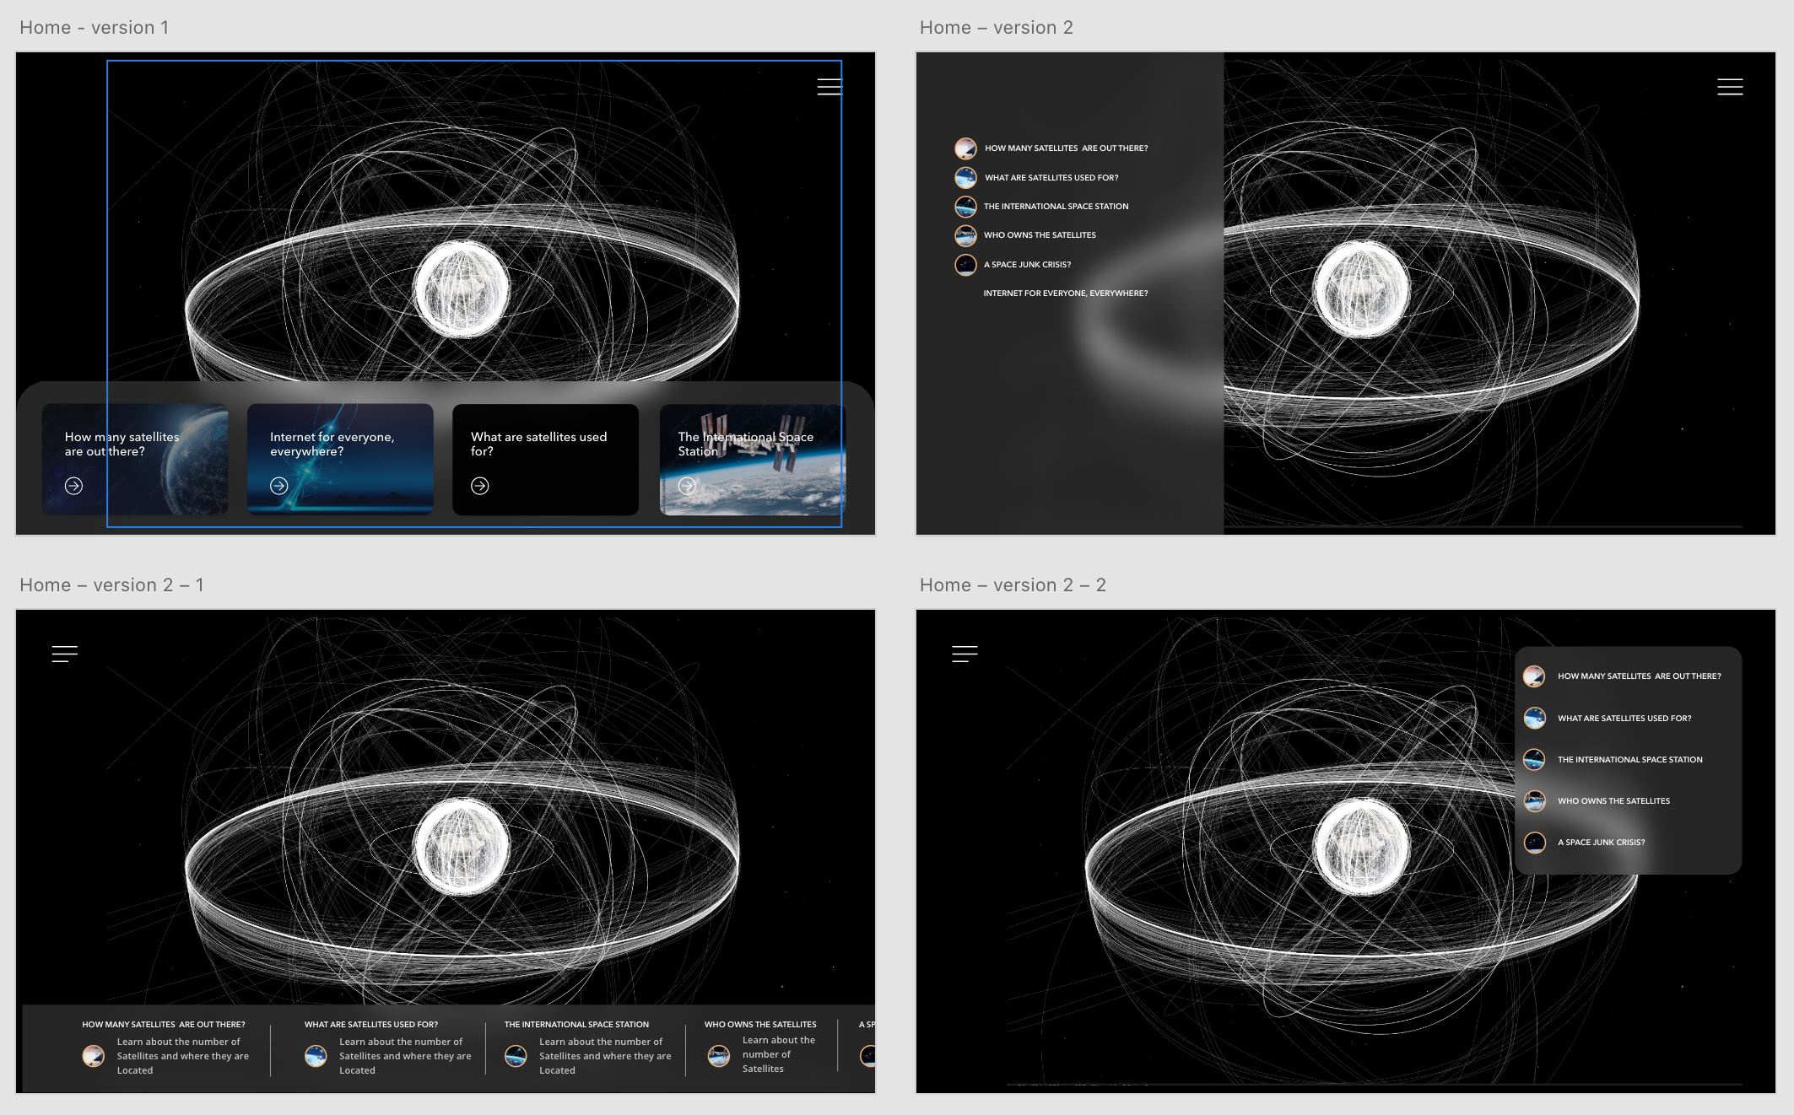
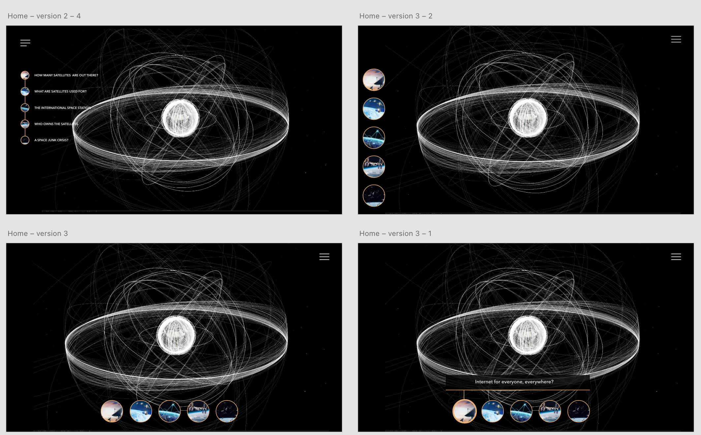
Satellite Explorer - sketch

Slide 17
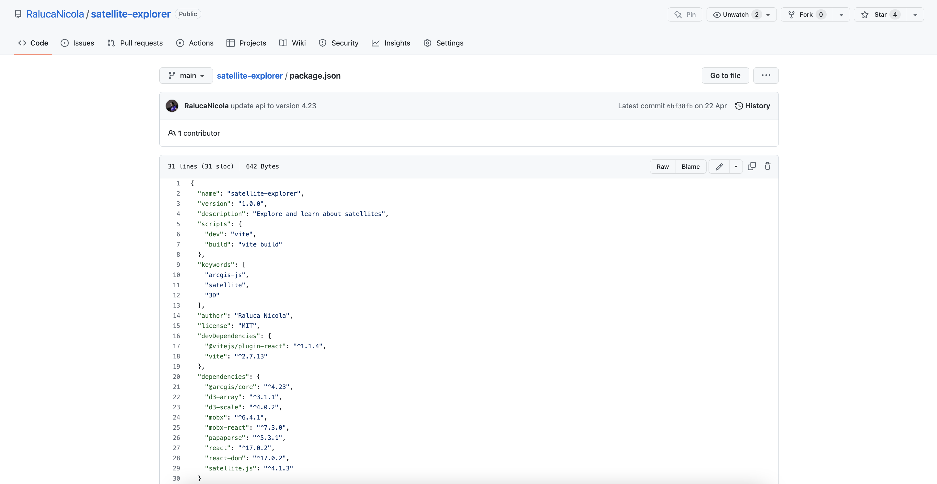
Satellite Explorer - code
https://github.com/RalucaNicola/satellite-explorer/

Slide 18
Satellite Explorer - demo
https://geoxc-apps.bd.esri.com/space/satellite-explorer/

Slide 19
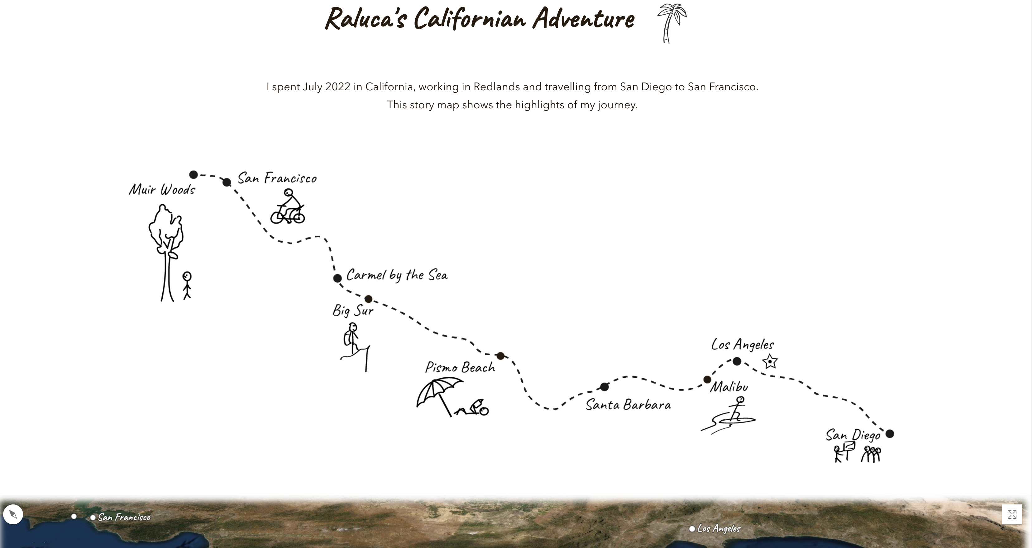
Personal - holiday map
https://ralucanicola.github.io/holiday-map/

Slide 20
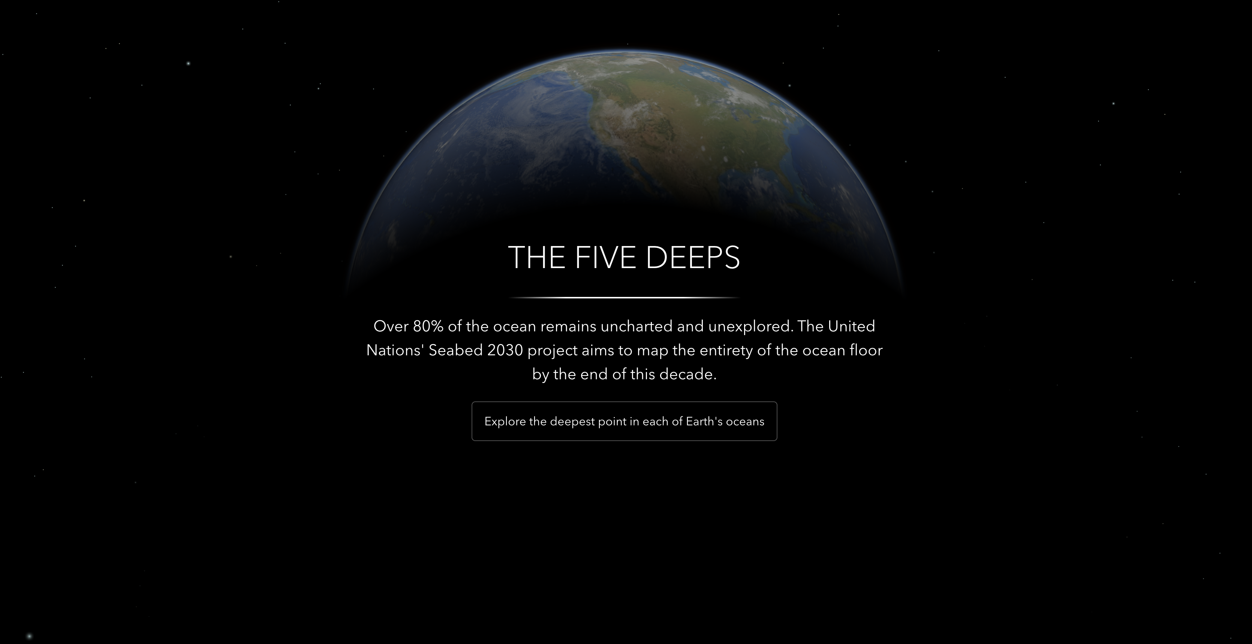
Discovery - the five deeps
https://geoxc-apps4.bd.esri.com/five-deeps/

Slide 21
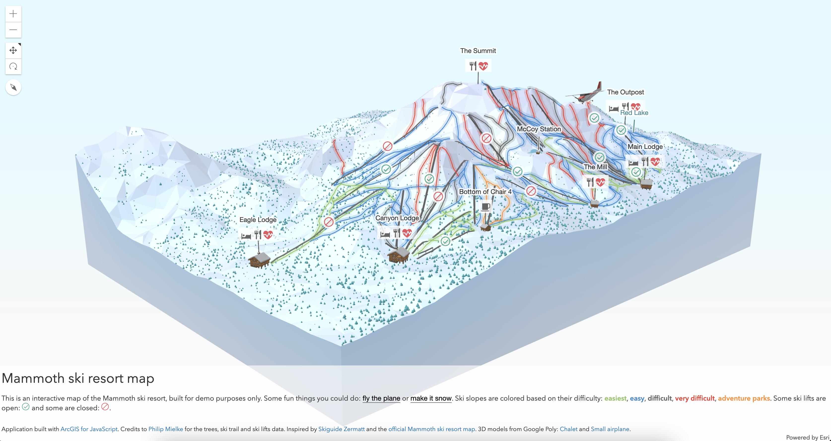
Game – ski resort map
https://ralucanicola.github.io/ski-resort-map/

Slide 22
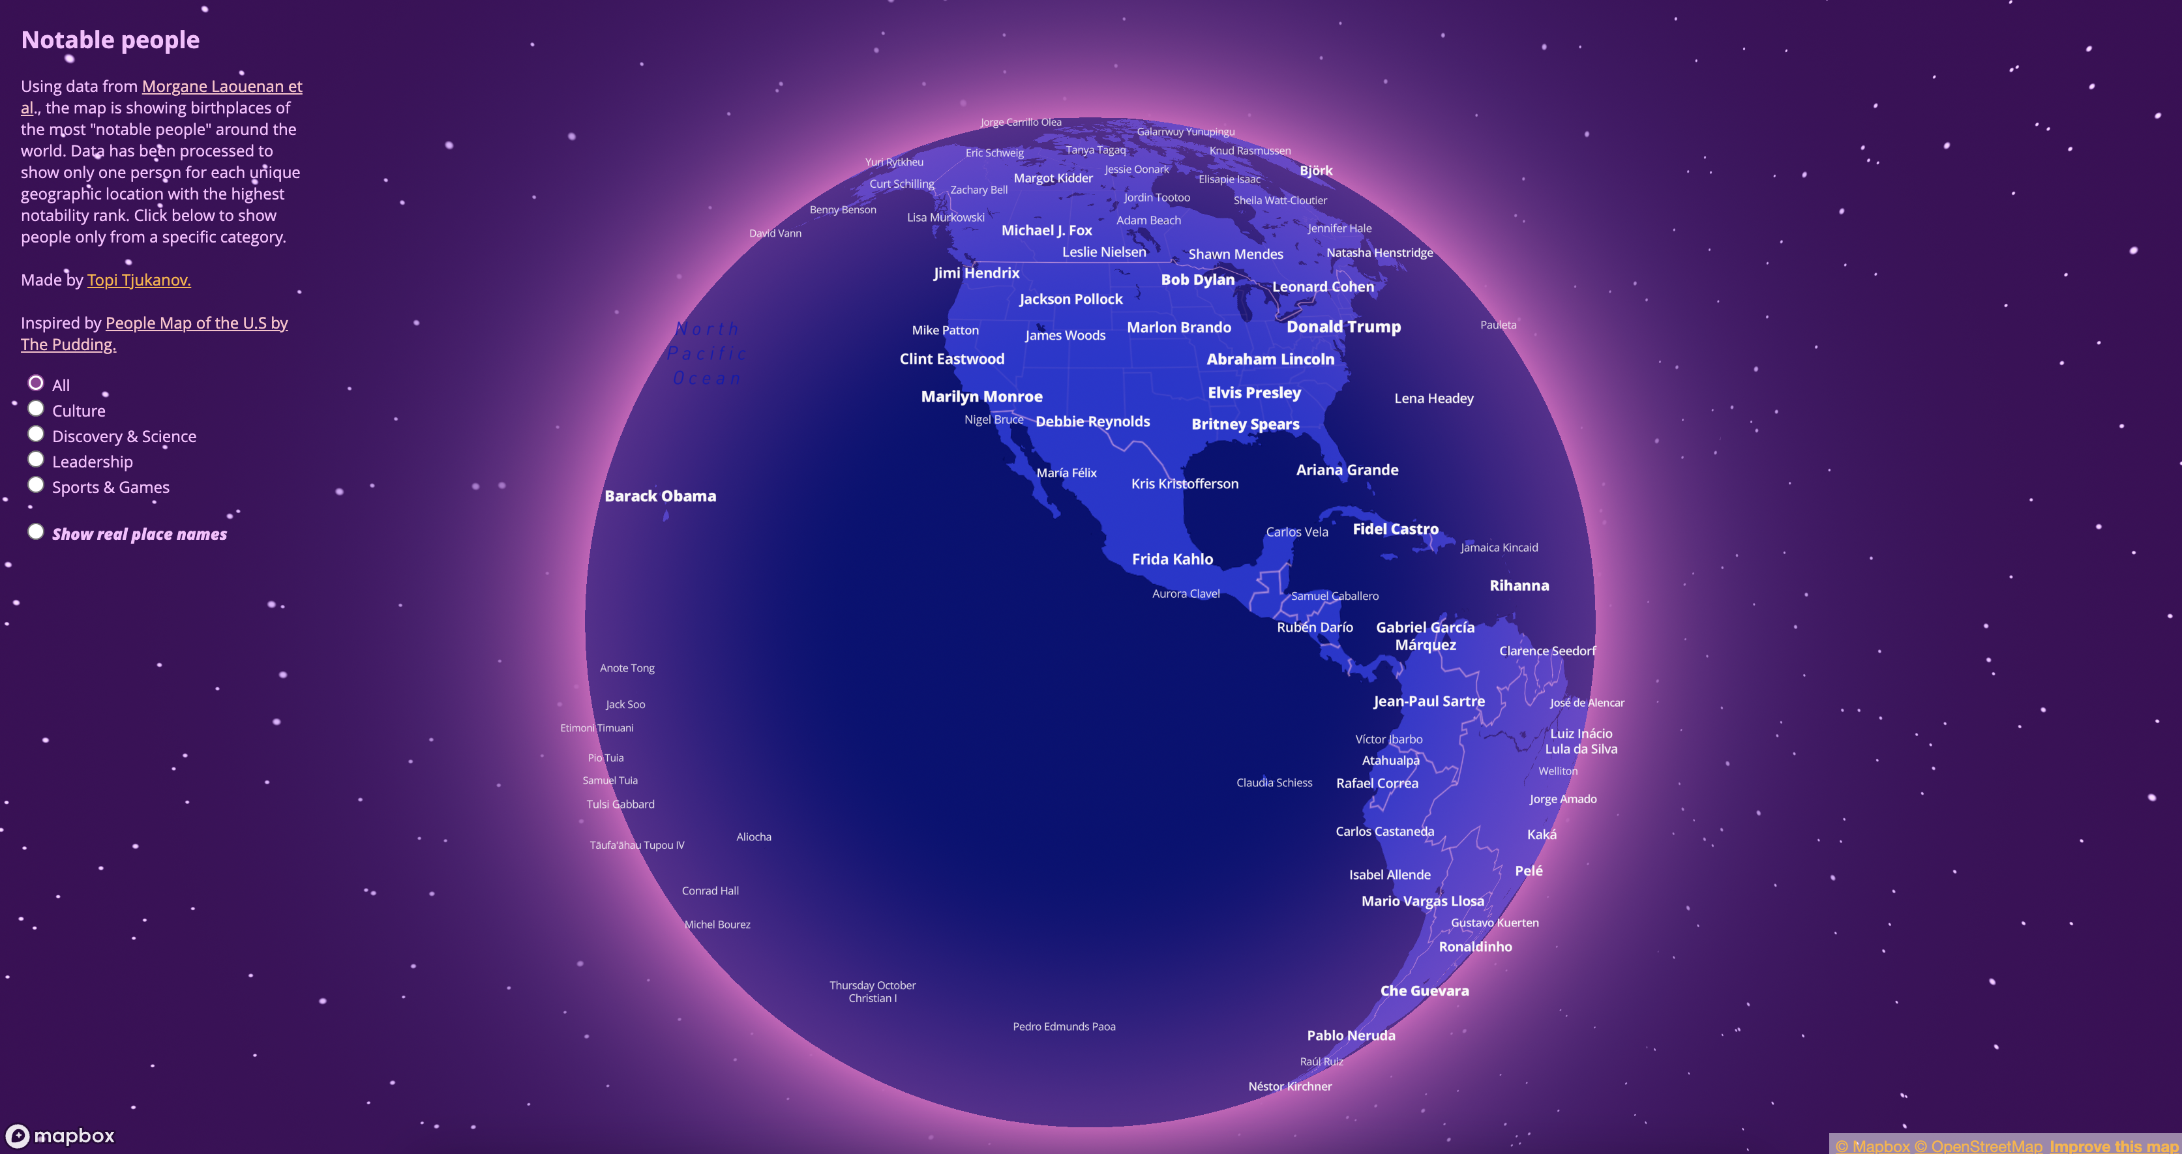
Entertainment – notable people
https://tjukanovt.github.io/notable-people

Slide 23
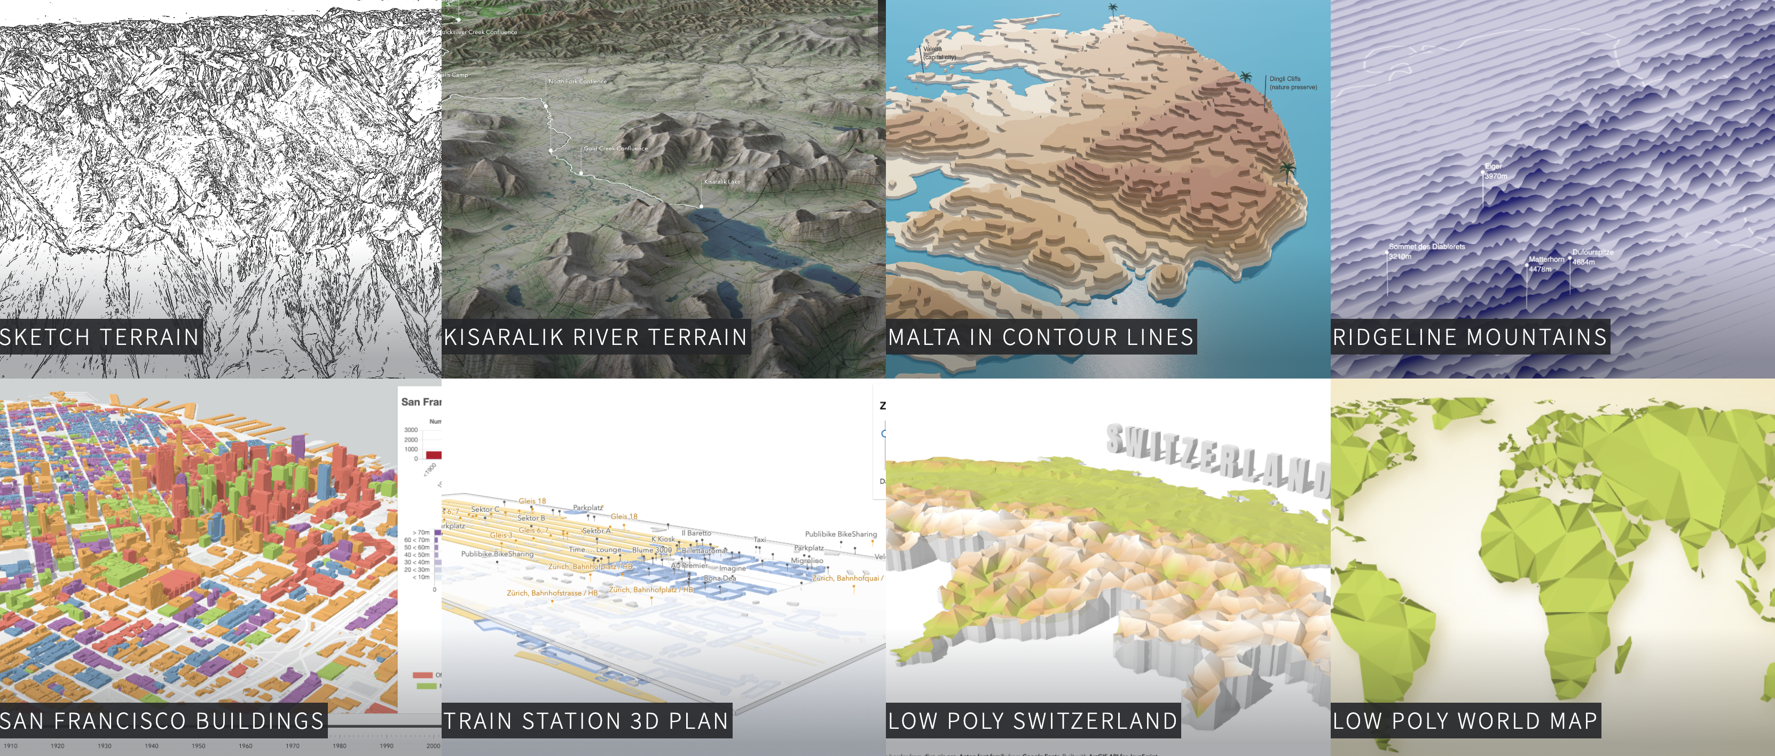
Experimental
https://ralucanicola.github.io/JSAPI_demos/

